Slide 1
HNDIT11062 – Web Development
Week 2: Internet Basics

Slide 2
Course Content
    The Internet: Then and Now
    How Internet Works
    Major Features of the Internet
    Online Services

Slide 3
    The Internet: Then and Now
The Internet was created by the Advanced Research Projects Agency (ARPA) and the U.S. Department of Defense (DOD) for scientific and military communications.
The Internet is a network of interconnected networks. Even if part of its infrastructure was destroyed, data could flow through the remaining networks.
The Internet uses high-speed data lines, called backbones, to carry data. Smaller networks connect to the backbone, enabling any user on any network to exchange data with any other user.
ARPANET, NSFnet, Internet
Internetworking : the process of connecting separate networks

Slide 4
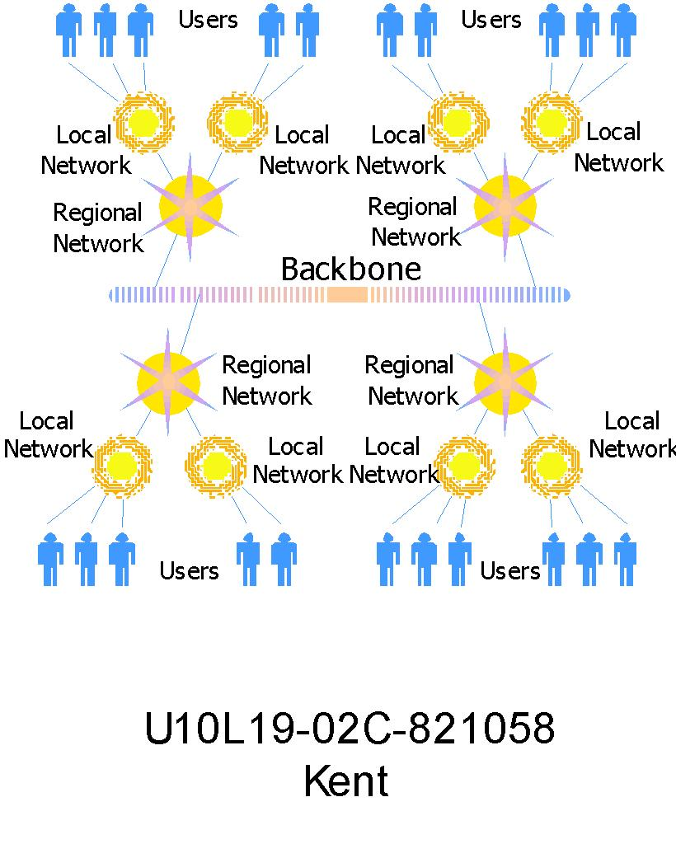

Slide 5
    How Internet Works
TCP/IP
Routing Traffic Across the Internet
Addressing Schemes
Domains and Sub domains

Slide 6
    How Internet Works…
    TCP/IP
Every computer and network on the Internet uses the same protocols (set of guidelines or rules and procedures) to control timing and data format.
The protocol used by the Internet is the Transmission Control Protocol/Internet Protocol, or TCP/IP.
No matter what type of computer system you connect to the Internet, if it uses TCP/IP, it can exchange data with any other type of computer.

Slide 7
    TCP/IP (Cont.)
    Single, common, worldwide standard
    US Department of Defense
      TCP, transmission control protocol
        Handle the movement of data
        Breaks the original massage in to small packets & sequentially labels them.
      IP, Internet Protocol
        Delivery of packets
        Disassembling and reassembling of packets

Slide 8
How Internet Works…
Routing Traffic Across the Internet
Most computers don't connect directly to the Internet. Instead, they connect to a smaller network that is connected to the Internet backbone.
The Internet includes thousands of host computers (servers), which provide data and services as requested by client systems.
When you use the Internet, your PC (a client) requests data from a host system. The request and data are broken into packets and travel across multiple networks before being reassembled at their destination.

Slide 9
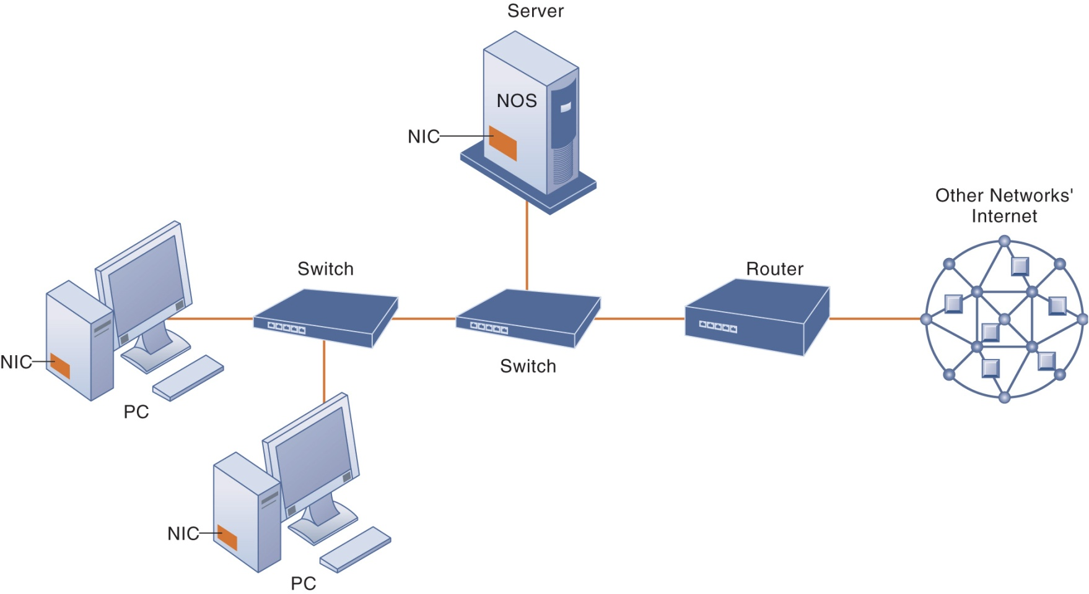
Network: consist of two or more connected computers

Slide 10
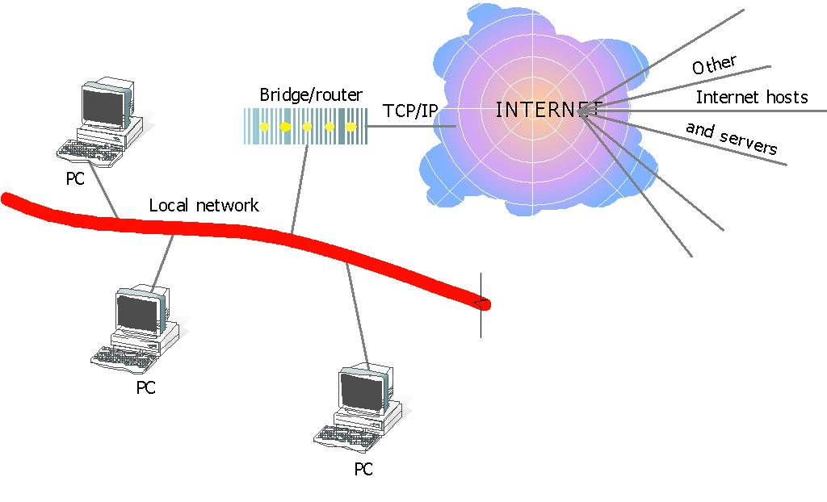

Slide 11
    How Internet Works…
    Addressing Schemes
In order to communicate across the Internet, a computer must have a unique address.
Every computer on the Internet has a unique numeric identifier, called an Internet Protocol (IP) address.
Each IP address has four parts – each part a number between 0 and 255. An IP address might look like this:
e.g. 205.46.117.104.

Slide 12
    How Internet Works …
    Domains and Sub domains
In addition to an IP address, most Internet hosts or servers have a Domain Name System (DNS) address, which uses words.
A domain name identifies the type of institution that owns the computer. An Internet server owned by IBM might have the domain name ibm.com.
The last part of the domain name is called the Top-Level Domain (TLD) or Zone and is either two or three letters long.
The second-to-last part of the domain name is called the Second-Level Domain, and It chosen by the organization that owns the computer. e.g. whitehouse.gov
  ibm.com
slt.net

Slide 13
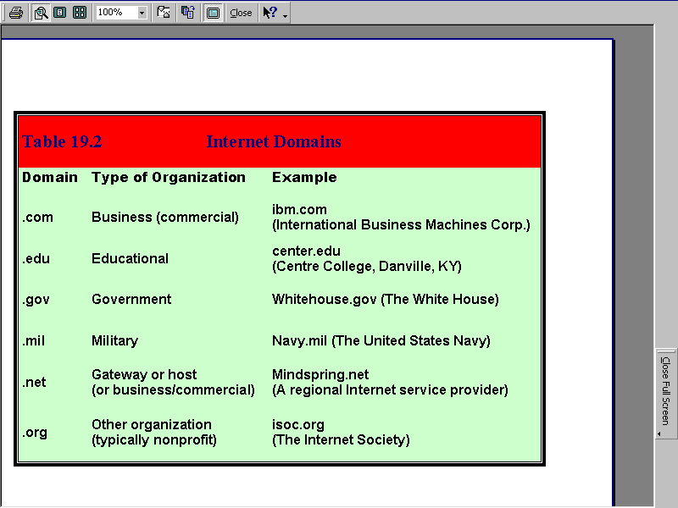
Three-letter zones (mainly used in the U.S.) indicate the type of organization that owns the domain.

Slide 14
    Domains and Sub domains (cont.)
The two-letter zones indicate the country in which the organization that owns the computer is located.
e.g. U.S. - .us
Canadian - .ca
Sri Lankan - .lk
Some enterprises have multiple servers, and identify them with sub domains
e.g. products.ibm.com.
Currently, domains in the com, edu, net and org zones are assigned by Network Solutions’ InterNIC Registration Services, at http://www.internic.net

Slide 15
Principals of name spaces are administered by the Internet Corporation for Assigned Names and Numbers (ICANN) . Including :
domain names
Internet Protocol (IP) addresses
application port numbers in the transport protocol
& many other parameters.
Internet governances

Slide 16
Internet governances…..
The internet is a globally distributed network comprising many voluntarily interconnected autonomous network. It operates a central governing…
However,
to maintain interoperability, all technical & policy aspects of the underlying core infrastructure & the principal name spaces are administered by the Internet Corporation for Assigned Names & Numbers.. (ICANN)

Slide 17
Major Features of the Internet
The World Wide Web
E-Mail
News
Telnet
File Transfer Protocol (FTP)
Internet Relay Chat (IRC)

Slide 18
    Major Features of the Internet…
    The World Wide Web (WWW)
The World Wide Web, abbreviated as WWW and commonly known as the Web, is a system of interlinked hypertext documents accessed via the Internet.
WWW is a part of the Internet, which supports hypertext documents, allowing users to view and navigate different types of data.
With a web browser, one can view web pages that may contain text, images, videos, and other multimedia and navigate between them via hyperlinks.
Every Web page has an address, a Uniform Resource Locator (URL).

Slide 19
Hypertext
Hypertext is text which contains links to other texts.
Hypertext, made famous by the World Wide Web, is most simply a way of constructing documents that reference other documents.
Hypertext document is written in HTML Language.
    Hyper Text Markup Language
    Based on SGML (Standard Generalized Markup Language)
    Describes the Structure of the document

Slide 20
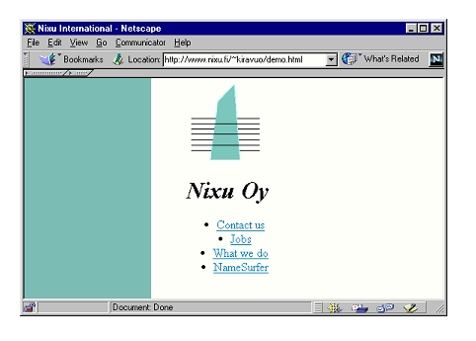

Slide 21
HTML Code
<HTML> <HEAD> <TITLE>Nixu International</TITLE> </HEAD> <BODY background="/gfx/back1.gif"> <CENTER> <IMG SRC="/gfx/logo.gif" ALT="Nixu Oy"><BR> <H1><I>Nixu Oy</I></H1> <UL> <LI><A HREF="/yhteysti.html">Contact us</A> <LI><A HREF="/avoimett/">Jobs</A> <LI><A HREF="/palvelut/">What we do</A> <LI><A HREF="http://www.namesurfer.com/"> NameSurfer</A> </UL> </CENTER> </BODY> </HTML>

Slide 22
URL • Universal Resource Locator • URL is an address to the current location of information
protocol://host[:server port]/path/file.html protocol://host[:server port]/path/ • For example http://www.hut.fi/ http://www.nixu.fi/~kiravuo/etiketti/index.html news:sfnet.harrastus.retkeily ftp://ftp.funet.fi/rfc/ • WWW browser uses the URL address to retrieve a document over the network

Slide 23
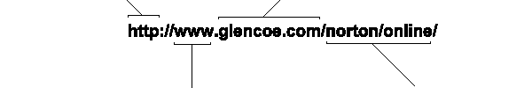
This address is for an
Internet server that uses
The hypertext transfer protocol.
This site belongs to a
company named Glencoe.
This site is on the part
of the Internet known
as the World Wide Web.
To find the specific Web pages
that accompany this book, your
browser follows the URL’s path
to a folder named “norton,” then
to a subfolder named “online.”

Slide 24
Hyperlink
In computing, a hyperlink (or link) is a reference to a document that the reader can directly follow, or that is followed automatically.
A hyperlink points to a whole document or to a specific element within a document.
  HTML allows designers to link content together via hyperlinks.

Slide 25
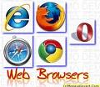
Web Browser
A web browser or Internet browser is a software application for retrieving, presenting, and traversing information resources on the World Wide Web.

Slide 26
Web Browsers
The very first web browser was written by Tim burners Lee.
Mosaic (1993) was first point-and-click browser, which was written by Marc Andreessen and other undergraduate students at the National Center for Supercomputing Applications NCSA) in the United States.
E.g.
                Internet Explore(IE)
                Firefox
                Opera
                Chrome
                Safari
                Netscape Navigator

Slide 27
Process of web browser
Browser request for information
SERVER
BROWSER
`Server searches for the information and sent it to the browser

Slide 28
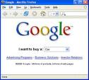
Search Engines
A search engine is a piece of application software that sits on a powerful computer ( a server) on the Internet.
Search engines keep track of information available on the Internet.
E.g.
            Googlewww.google.com)
            Excitewww.excite.com)
            Lycoswww.lycos.com)
            Info seek Guide(www.infoseek.com)
            WebCrawler(www.webcrawler.com)
            World wide web worm (www.goto.com)
            AltaVista (www.altavista.com)

Slide 29
Search Engines…
Advantages
Control over search: search terms can be combined as required
search can be limited to period of time, field, source type etc..
Currency of information made possible by regular addition by web spiders.
Best suited for complex keyword/concept searches.
Disadvantages
            False positives
            Search engines vary in terms of search techniques/syntax
            Dead links, redundant links(same document gets displayed)
            Spamming (salting of pages)

Slide 30
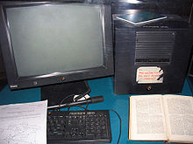
The world’s first web server
Web Server
Web servers are computers that deliver (serves up) Web pages.
In 1989 Tim Berners-Lee proposed The web servers
Any computer can be turned into a Web server by installing server software and connecting the machine to the Internet.
web server refers to both hardware and software.
E.g.
    Apache
    IIS (Internet Information Server)
    Tomcat
    Glassfish

Slide 31
Client server architecture
The client-server model is a pattern of network communication in which clients send requests to servers over a computer network and the servers send back responses.
Servers are powerful computers or processes dedicated to managing disk drives (file servers), printers (print servers), or network traffic (network servers ).
      Each Web server has a unique address (IP address) and domain name
      Provide services such as Web hosting
Clients are PCs or workstations on which users run applications.

Slide 32
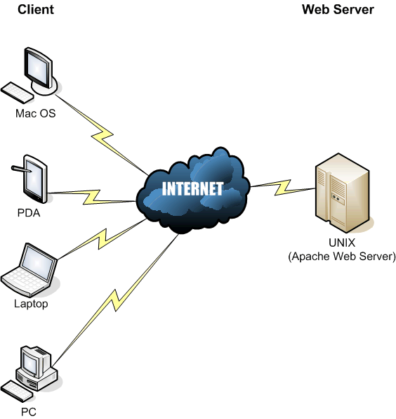
Main process of web sever

Slide 33
Client-Side languages/styles
HTML (Hyper Text Mark up Language) – designing for the statistic web pages
CSS (Cascade Style Sheets) – used to add styles for the HTML pages.
XML (Extensible Markup Language) - XML was designed to transport and store data.
Java Scripts - JavaScript is THE scripting language of the Web.

Slide 34
Server-Side languages/styles
PHP (Personal Home Page) - PHP is a powerful tool for making dynamic and interactive Web pages. Also Provides simple, but powerful database access.
ASP.NET (Active Server Pages) - ASP.NET is an entirely new technology for server-side Programming.
JSP/Servlet – Server side technologies using the Java Programming languages.

Slide 35
    Major Features of the Internet…
    E-Mail
Electronic mail (e-mail) is the most popular reason people use the Internet.
To create, send, and receive e-mail messages, you need an e-mail program and an account on an Internet mail server with a domain name.
To use e-mail, a user must have an e-mail address, which you create by adding your user name to the e-mail server's domain name, as in
e.g jsmith@gmail.com.

Slide 36
Major Features of the Internet…
News
One Internet-based service, called news, includes tens of thousands of newsgroups.
Each newsgroup hosts discussions on a specific topic. A newsgroup's name indicates its users' special topic of interest, such as alt.food.cake.
To participate in a newsgroup, you need a newsreader program that lets you read articles that have been posted on a news server. You can post articles for others to read and respond to.

Slide 37
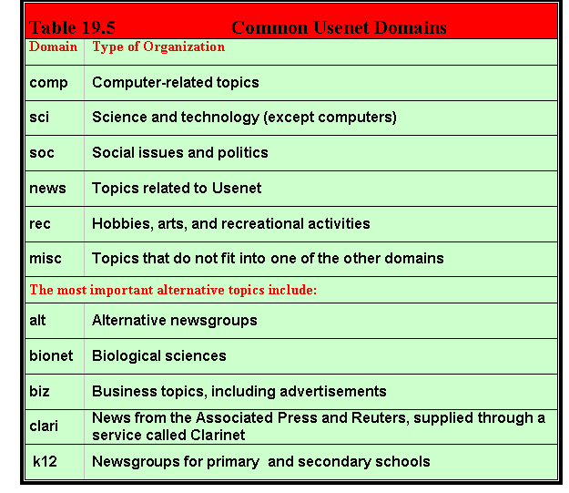

Slide 38
Major Features of the Internet…
Telnet
Telnet is a specialized service that lets you use one computer to access the contents of another computer – a Telnet host.
A Telnet program creates a "window" into the host so you can access files, issue commands, and exchange data.
Telnet is widely used by libraries, to allow visitors to look up information, find articles, and so on.

Slide 39
Major Features of the Internet…
File Transfer Protocol (FTP)
File transfer protocol (FTP) is the Internet tool used to copy files from one computer to another.
Using a special FTP program or a Web browser, you can log into an FTP host computer over the Internet and copy files onto your computer.
FTP is handy for finding and copying software files, articles, and other types of data. Universities and software companies use FTP servers to provide visitors with access to data.

Slide 40
FTP (cont.)
FTP, the protocol for exchanging files over the Internet.
FTP works in the same way as HTTP for transferring Web pages from a server to a user's browser and SMTP for transferring electronic mail across the Internet in that, like these technologies, FTP uses the Internet's TCP/IP protocols to enable data transfer.
FTP is most commonly used to download a file from a server using the Internet or to upload a file to a server (e.g., uploading a Web page file to a server).
Transfer data reliably and efficiently

Slide 41
Anonymous FTP
Using the Internet's File Transfer Protocol (FTP), anonymous FTP is a method for giving users access to files so that they don't need to identify themselves to the server.
Using an FTP program or the FTP command interface, the user enters "anonymous" as a user ID. Usually, the password is defaulted or furnished by the FTP server.
Anonymous FTP is a common way to get access to a server in order to view or download files that are publicly available.
If someone tells you to use anonymous FTP and gives you the server name, just remember to use the word "anonymous" for your user ID. Usually, you can enter anything as a password.

Slide 42
FTP Client Commands (issued by user interface)
Command | Description
get filename | Retrieve file from server
mget filename* | Retrieve multiple files from server*
put filename | Copy local file to server
mput filename* | Copy multiple local files to server*
open server | Begin login to server
bye / close / exit | Logoff server
ls / dir | List files in current remote dir on server
lcd | Change local directory
cd | Change remote directory
rhelp / remotehelp | Lists commands the server accepts

Slide 43
Major Features of the Internet…
Internet Relay Chat (IRC)
Internet Relay Chat (IRC) is a service that allows users to communicate in real time by typing text in a special window.
Like news, there are hundreds of IRC "channels," each devoted to a subject or user group.
You can use a special IRC program to participate in chatroom discussions, but many chatrooms are set up in Web sites, enabling visitors to chat directly in their browser window.

Slide 44
Online Services
An online service is a company that provides access to e-mail, discussion groups, databases on various subjects, and the Internet.
America Online, CompuServe, and Prodigy are examples of popular online services.

Slide 45
lesson review
Name two organizations that created the network now called the Internet.
Explain the importance of TCP/IP to the Internet.
Describe the basic structure of the Internet.
Describe how Internet operate.
List the major services the Internet provides to its users.

